Slide 1
Virtual Telepresence Robot
Guided By –
K V Shanthala
Presented By –
Kiran A – 1JS19CS076
NikhilRaju – 1JS19CS102
Mudasir Ahamed – 1JS19CS091
Prithviraj Patil - 1JS19CS125

Slide 2
Abstract:
Augmented reality, robotics, and virtual reality can team up to develop innovative applications in various fields. In this project a robot with a camera is placed in a remote location to capture the environment in visual form using Raspberry Pi (RPi) and the captured visuals are displayed on the user’s virtual reality (VR) headset. An added feature allows the camera to move in the direction of the user’s head movements .This gives the user a real time experience as if he is present where the virtual tele-presence robot is located. The virtual telepresence robot can also be moved in any direction through an app installed in the users smartphone.

Slide 3
Methodology
Two servo motors are used to move the camera—one for the vertical movement and the other for the horizontal movement. So when you turn your head along with VR headset to the right side, the Raspberry Pi camera will also turn to the right direction . The smartphone also provides input to the Arduino Mega (Board) for the purpose of navigation or movement of the robot. The motor driver IC and geared motors are connected at the end of the navigation circuit . The commands to run the robot can be sent via Bluetooth from the smartphone.

Slide 4
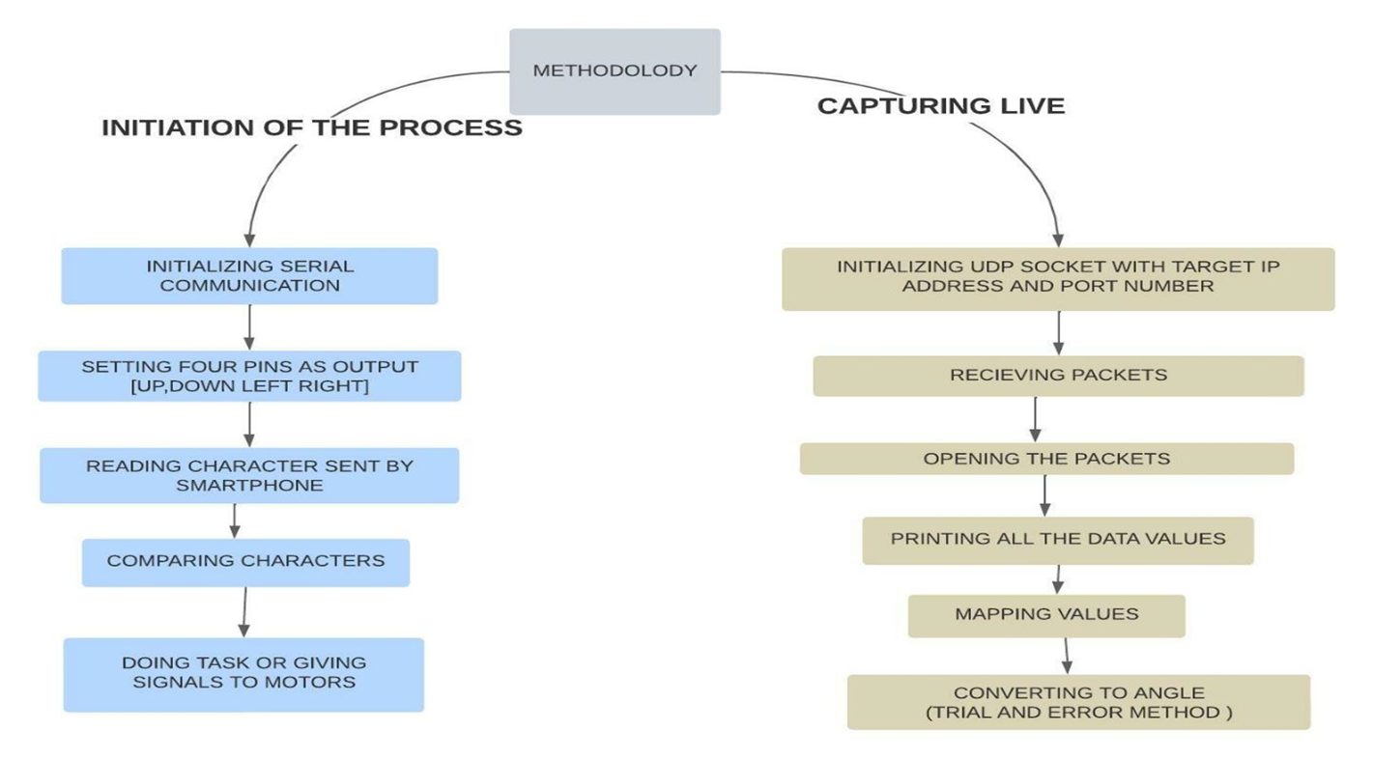

Slide 5
System Requirements
Raspberry pi processor.
SD card.
Arduino
Pi camera
VR head set
Servo motor
Bluetooth Module
Smartphone with internet connection.
Python Programming
Hyper Terminal

Slide 6
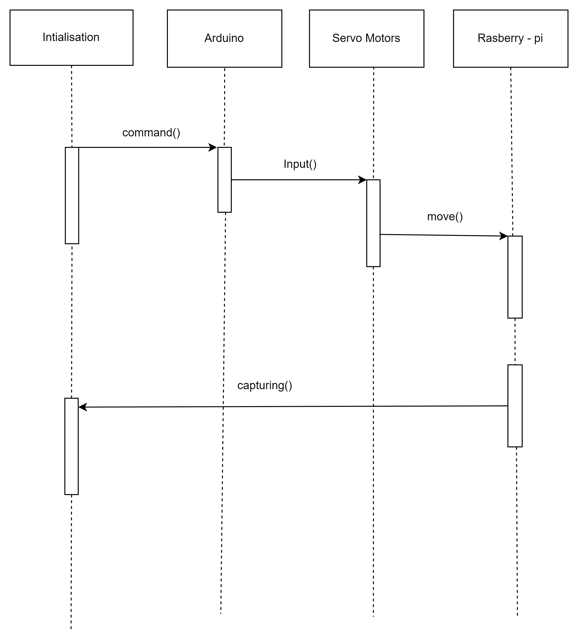
Sequence Diagram

Slide 7
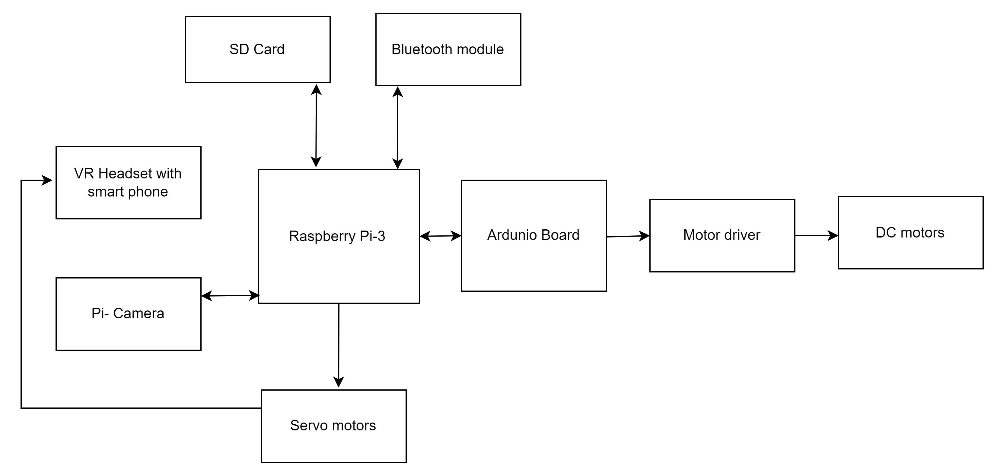
Architecture Diagram

Slide 8
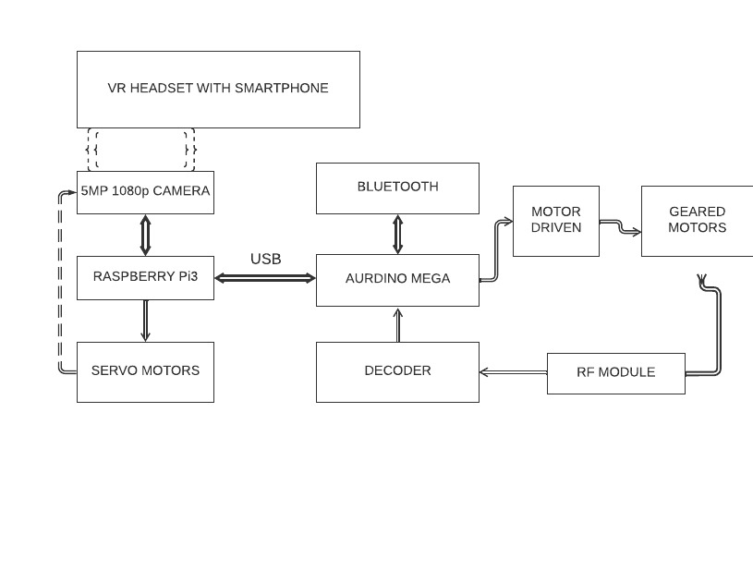
UML Diagram

Slide 9
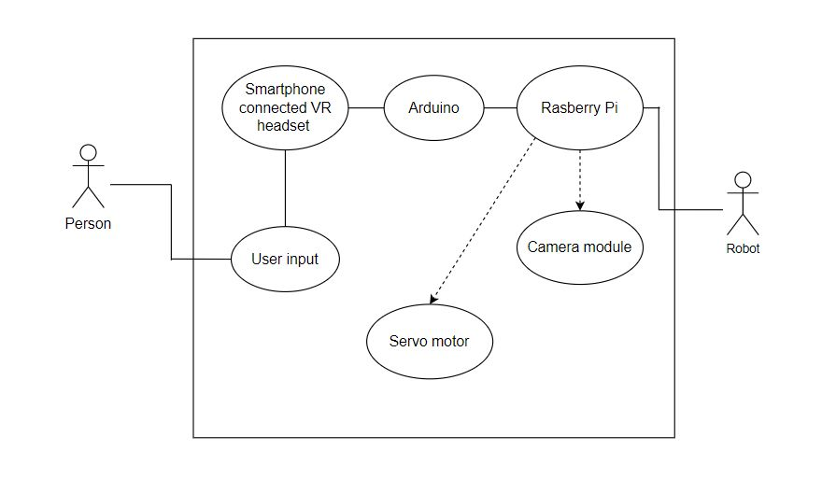
Use Case Diagram

Slide 10
THANK YOU

